Slide 1
STUDENT PERFORMANCE SYSTEM

Slide 2
Table of contents
INTRODUCTION
FEATURES
TECHNOLOGY USED
USE CASE
SCREENSHOTS
ADVANTAGES
DISADVANTAGES
FUTURE SCOPE
CONCLUSION

Slide 3
INTRODUCTION
This system helps to track and improve student performance easily.
Users enter marks for each subject. The system calculates performance level as Distinction, Medium, Low.
Identifies students with low performance.
Provides subject-wise video links to help students improve in weak areas.

Slide 4

FEATURES
Easy mark entry for multiple subjects.
Auto-calculates performance level.
Highlights subjects with low performance.
Provides subject-specific YouTube video links for improvement.

Slide 5
TECHNOLOGY USED
IDE : Spyder
Language : Python
Database : SQLite

Slide 6
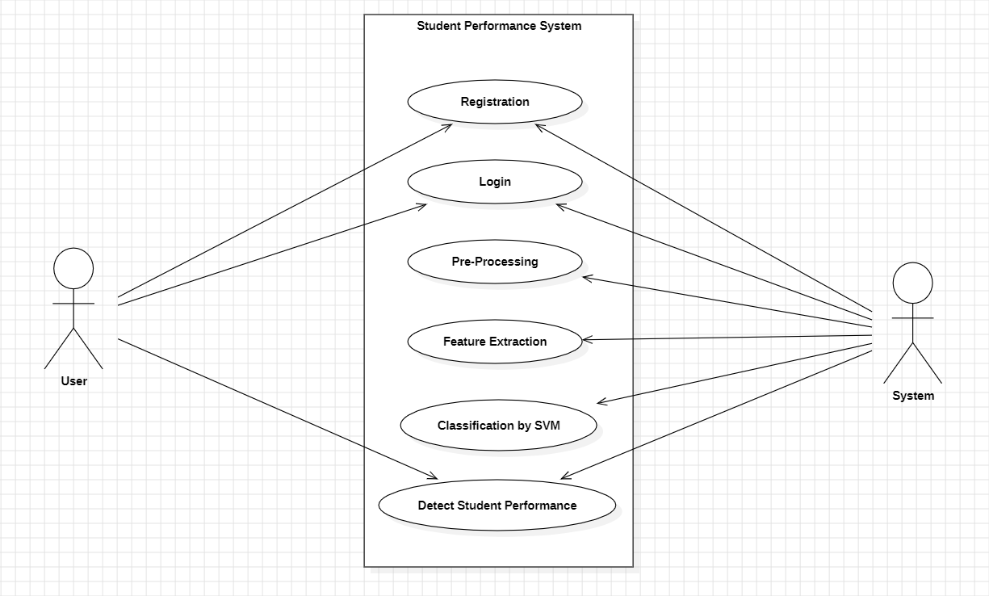
USE CASE

Slide 7
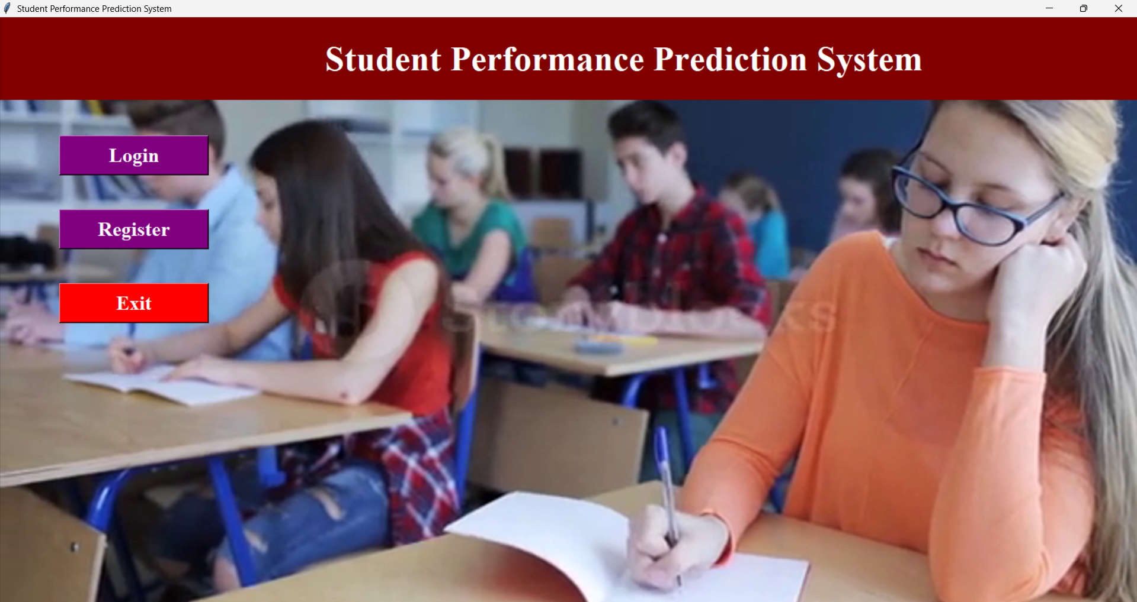
SCREENSHOTS

Slide 8
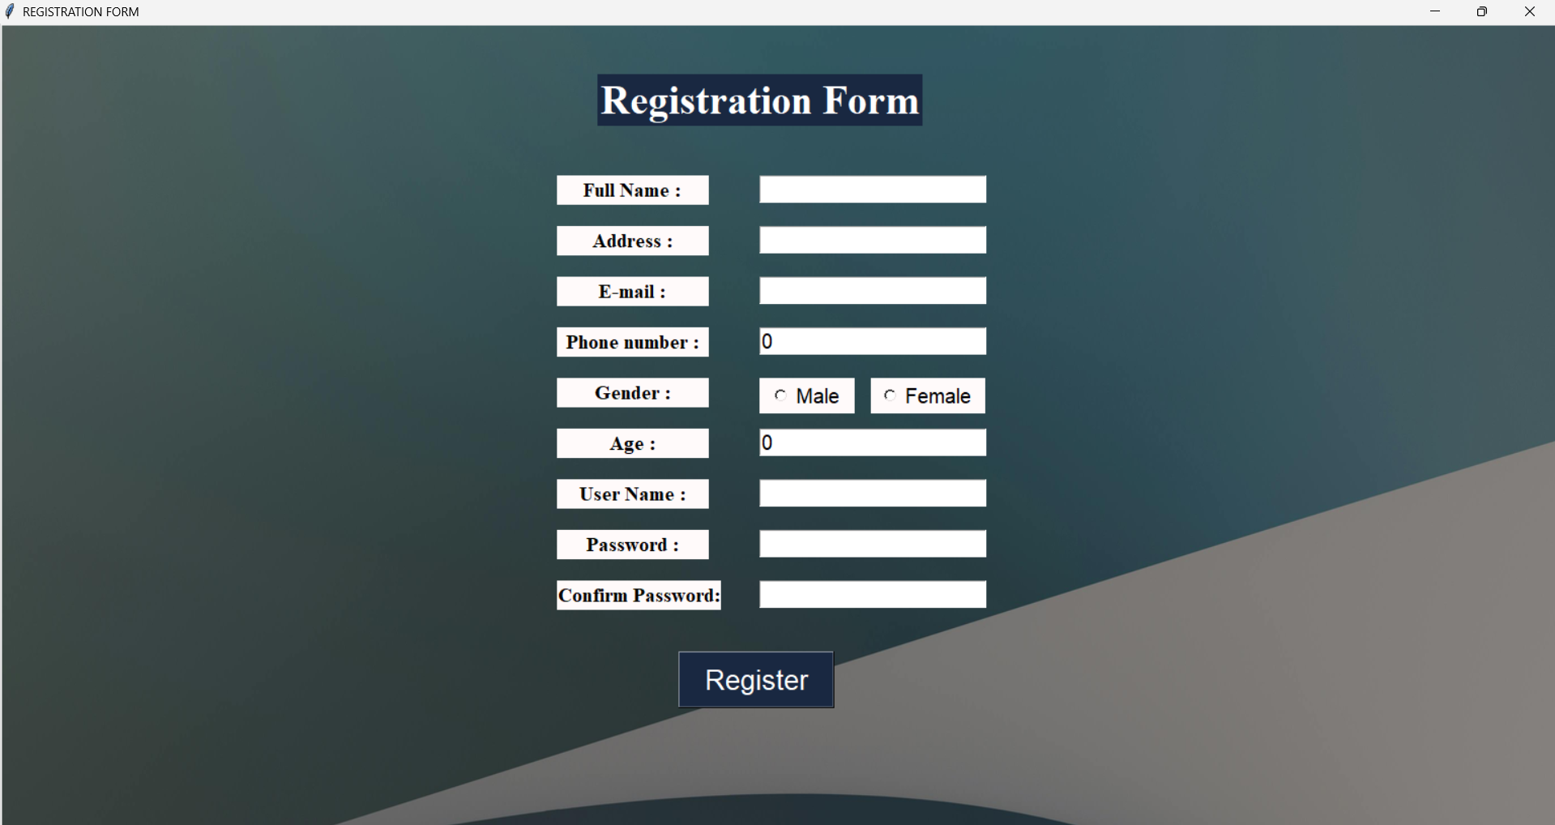
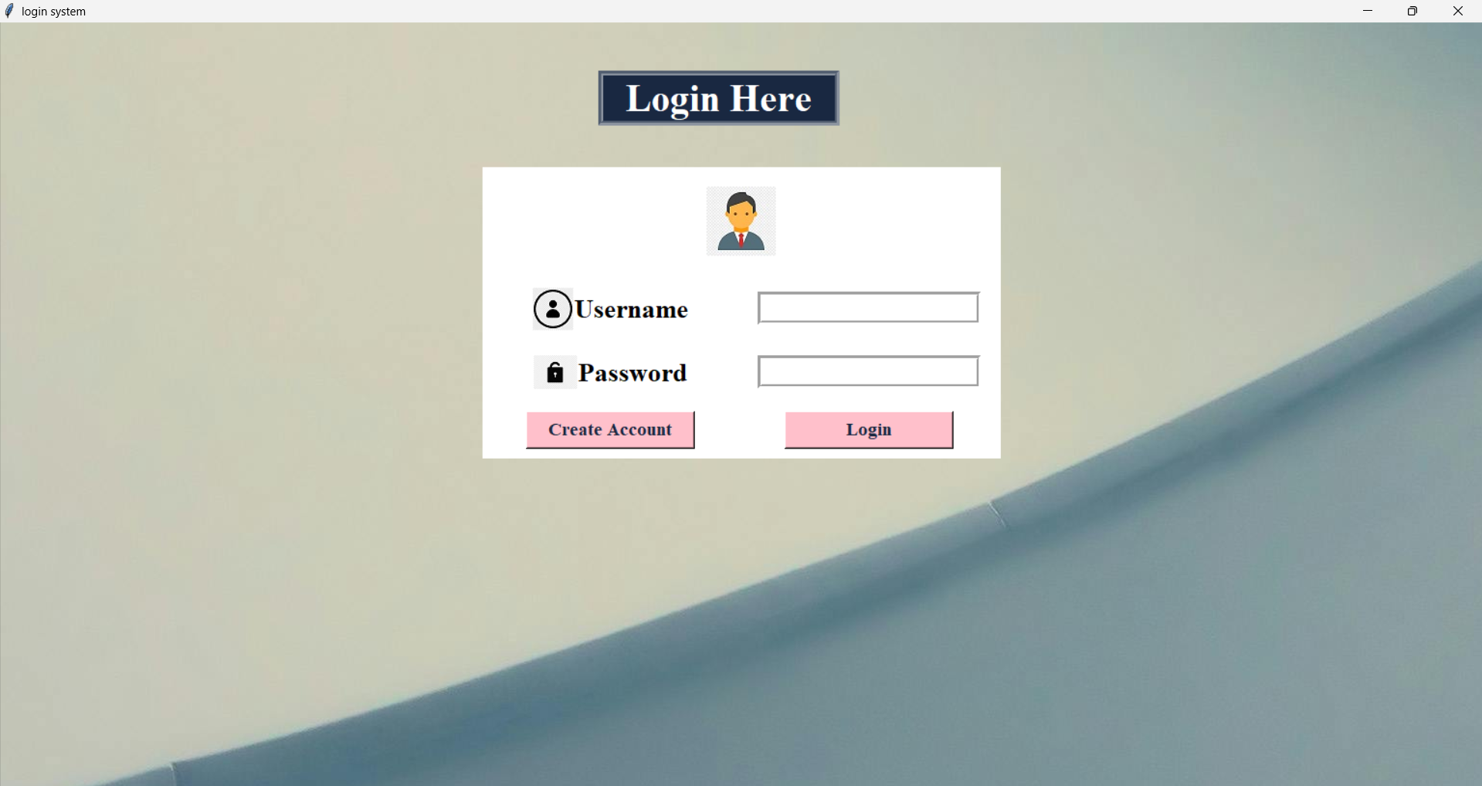

Slide 9
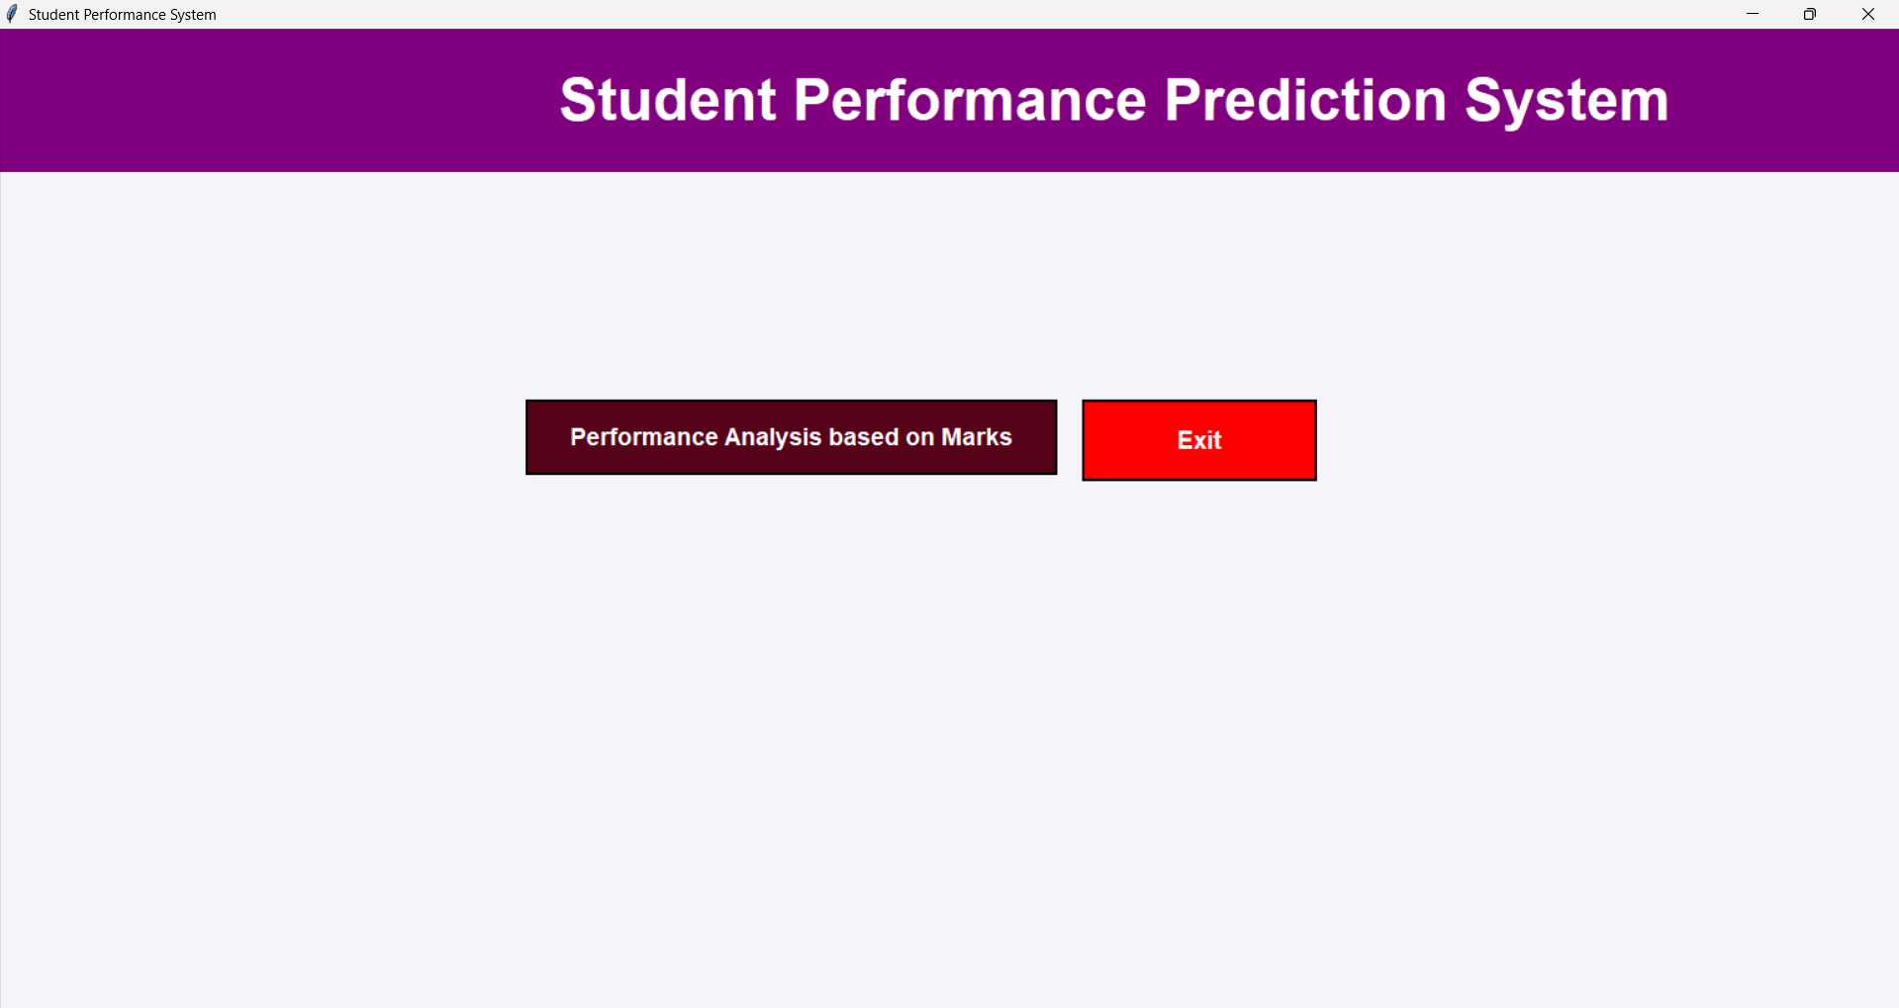
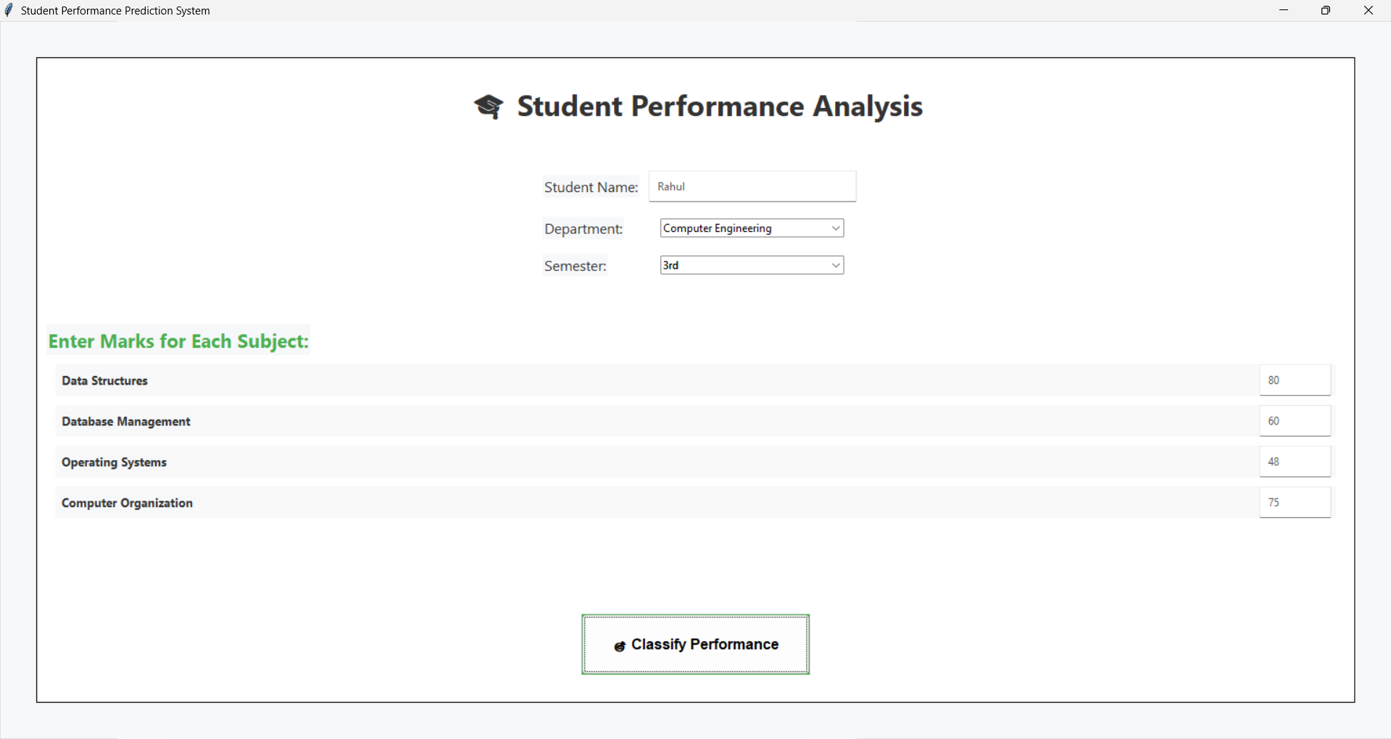

Slide 10
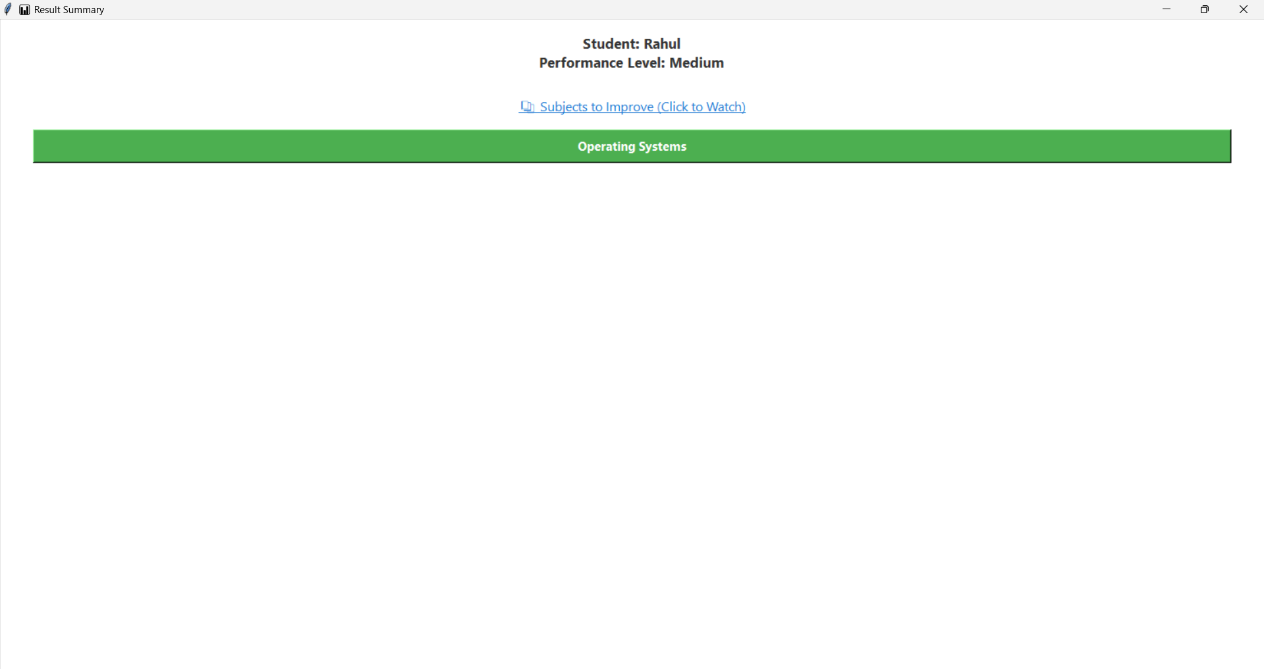

Slide 11
ADVANTAGES
Easy to Use
Clear Performance Tracking
Easy Data Storage
Personalized Recommendations

Slide 12

DISADVANTAGES
Limited Accessibility
Relies on Accurate Data
Limited Collaboration

Slide 13
Future scope
Add graphical performance reports for better insights.
Include student login to track personal progress.
Use AI to give personalized learning recommendations.

Slide 14
CONCLUSION
The Student Performance System makes it easy to track and improve student results.
It saves time for teachers and gives students the help they need.
A step forward in making education smarter and more effective.

